Slide 1
Azure Storage Services

Slide 2
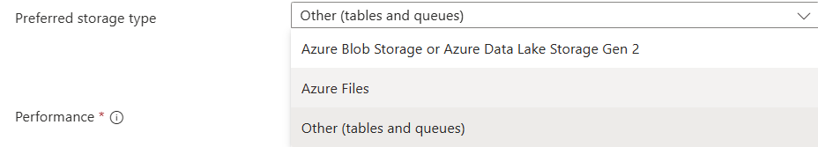
Storage Account types
Majorly 5 types of storage accounts
1.Blob
2.ADLS2
3.Files
4.Queue
5.Table

Slide 3
Azure Blob Storage
What is Blob Storage?
Azure Blob Storage is object storage optimized for unstructured data such as:
Images, videos
Logs
Backups
Data lake files (CSV, JSON, Parquet)
Core Components
Storage Account
Container (like a folder)
Blob (actual object/file
Blob Types
Block Blob – default (text, images, videos)
Append Blob – logs, append-only data
Page Blob – VHDs (used by Azure VMs)

Slide 4
What is a Blob Container?
📦 Container = Folder in Cloud
A Blob Container is a logical grouping of blobs (files) inside a storage account.
Storage Account
└── Container
├── file1.csv
├── file2.parquet
└── images/
Why Containers?
Organize data
Control access (security)
Separate environments (raw / curated / prod)

Slide 5
How to Create a Blob Container
✅ Using Azure Portal
Go to Storage Account
Select Containers
Click + Container
Enter:
  Name: raw-data
  Public access level:
    Private (recommended)
Click Create

Slide 6
Example
az storage blob upload \
--account-name mystorage \
--container-name logs \
--name app.log \
--file app.log \
--tier Cool
Real-World Use Case
Application logs → Hot → Cool → Archive (Lifecycle Management)
What Are Access Tiers?
Access tires: Access tiers define how frequently data is accessed and cost structure.
Tier | Storage Cost | Access Cost | Access Speed | Min Duration
Hot | High | Low | Milliseconds | None
Cool | Medium | Medium | Milliseconds | 30 days
Archive | Very Low | High | Hours | 90 days

Slide 7
2. Azure Data Lake Storage Gen2 (ADLS Gen2)
What is ADLS Gen2?
A big data optimized storage layer built on top of Blob Storage.
Key Features:
Hierarchical Namespace (HNS)
→ Enables directories & file-level operations
POSIX-style ACLs
Optimized for analytics engines
  Azure Databricks
  Synapse
  Hadoop
Massive scale & throughput
abfss://raw@datalakestore.dfs.core.windows.net/sales/2024/data.parquet
Real-World Use Case
Enterprise data lake for ETL, ML, AI pipelines

Slide 8
Why ADLS Gen2 vs Blob?
Feature | Blob | ADLS Gen2
Folder operations | ❌ | ✅
Big data analytics | Limited | Optimized
ACLs | Limited | Full POSIX

Slide 9
3. Azure File Storage
What is Azure File Storage?
Fully managed cloud file shares accessible like a network drive.
Supported Protocols
SMB (Server Message Block)
  Windows
  Linux
NFS (Network File System)
  Linux-based workloads
Access Methods
Azure VM
On-prem servers (via VPN/ExpressRoute)
Azure File Sync
Example
Mount SMB on Windows:
net use Z: \\mystorage.file.core.windows.net\share

Slide 10
Use Cases
Lift-and-shift legacy apps
Shared config files
Home directories
Application shared storage

Slide 11
4. Azure Queue Storage
What is Queue Storage?
A message queue service for decoupling application components.
Key Concepts
Messages up to 64 KB
FIFO (approximate)
Visibility timeout
At-least-once delivery
Typical Flow
Producer adds message
Consumer reads message
Message processed
Message deleted

Slide 12
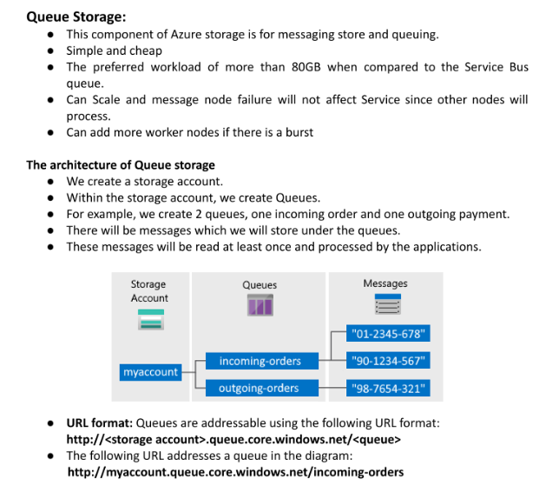

Slide 13
4. Azure Queue Storage
Example
from azure.storage.queue import QueueClient
queue = QueueClient.from_connection_string(conn_str, "orders")
queue.send_message("OrderID:123")
Use Cases
Background processing
Order processing
Event-driven microservices

Slide 14
5. Azure Table Storage
What is Table Storage?
A NoSQL, schema-less key-value storage.
Core Concepts
Table
Entity
PartitionKey
RowKey
Why PartitionKey?
Enables horizontal scalability
Determines data distribution

Slide 15
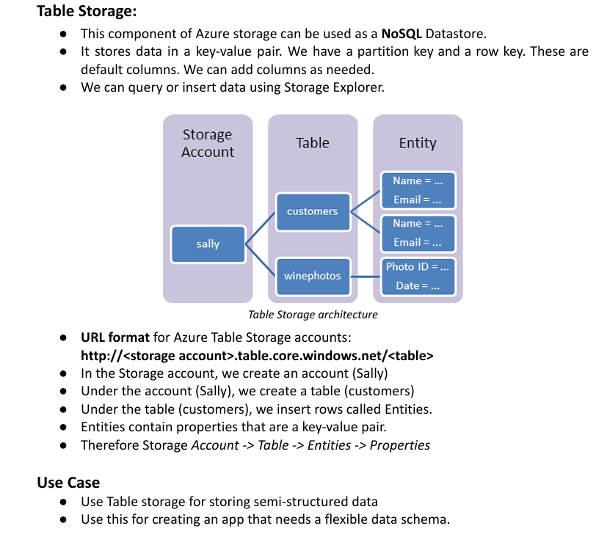

Slide 16
5. Azure Table Storage
Example Entity
{
"PartitionKey": "Customer",
"RowKey": "C001",
"Name": "Kumar",
"City": "Bangalore"
}
Use Cases
Metadata storage
IoT telemetry
User profile data
Configuration storage

Slide 17
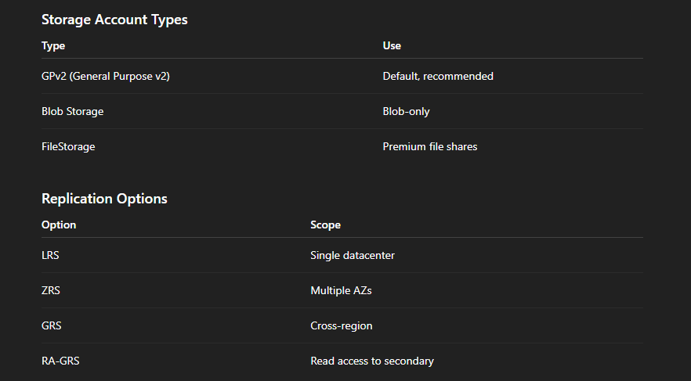
6. Storage Account Types & Replication Options

Slide 18
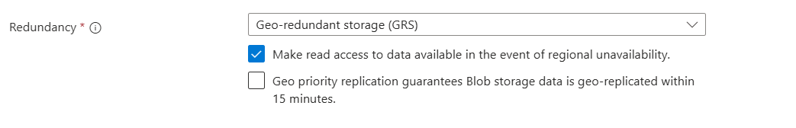
Storage replication options

Slide 19
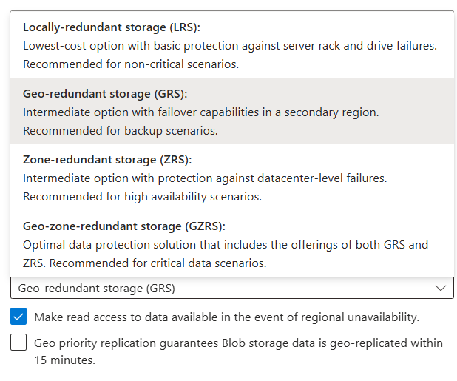

Slide 20
6. Storage Account Types & Replication Options
Example
az storage account create \
--name mystorage \
--sku Standard_GRS
Selection Criteria
Compliance
Disaster recovery
Cost vs availability

Slide 21
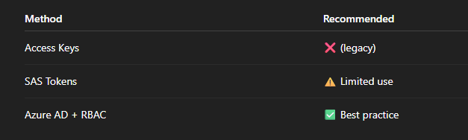
7. Azure Storage Security
Azure Storage supports three main authorization methods:
1️⃣ Access Keys
2️⃣ SAS Tokens (Shared Access Signature)
3️⃣ RBAC (Azure AD based access)

Slide 22
Access Keys (Old / Least Secure)
🔑 What are Access Keys?
Each Storage Account has 2 access keys
Full admin-level access
No identity, no expiry
📌 How it works
Anyone with the key can:
Read
Write
Delete
Change configuration

Slide 23
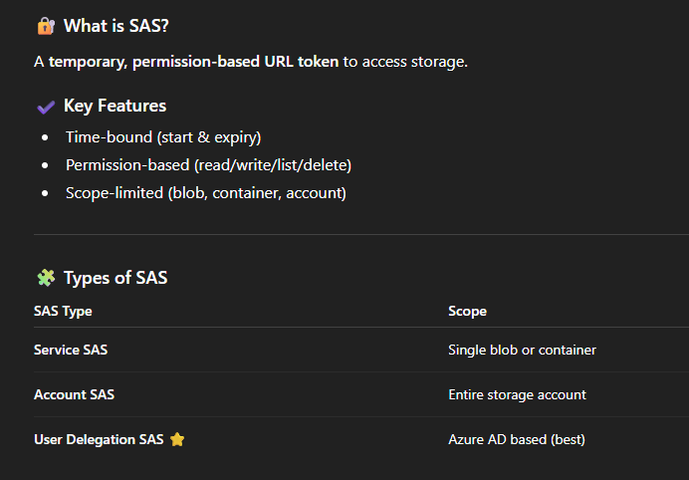
2️⃣ SAS Tokens (Shared Access Signature)
What is SAS?
A Shared Access Signature (SAS) is a secure, temporary URL token that grants limited access to Azure Storage resources without sharing the storage account access key.
Think of SAS as a temporary gate pass.

Slide 24
SAS
🔷 Why Do We Use SAS?
✔️ Temporary access
✔️ Permission-based access
✔️ Secure file sharing
✔️ No need to share access keys
Common Scenarios:
Share files with vendors for 24 hours
Allow upload/download without full access
External application access
Secure data exchange

Slide 25
7. Azure Storage Security
3️⃣ RBAC (Azure AD) – MOST SECURE
What is RBAC?
Role-Based Access Control using Azure Active Directory identities.
How it works
User / App / Service Identity
Assigned roles
No keys, no secrets
Role | Permissions
Storage Blob Data Reader | Read only
Storage Blob Data Contributor | Read + Write
Storage Blob Data Owner | Full control

Slide 26
Feature | Access Keys | SAS Tokens | RBAC
Security | ❌ Low | ⚠️ Medium | ✅ High
Expiry | ❌ No | ✅ Yes | ✅ Yes (identity)
User-based | ❌ No | ❌ No | ✅ Yes
Auditing | ❌ No | ⚠️ Limited | ✅ Full
Best for Prod | ❌ No | ⚠️ Limited | ✅ Yes

